Slide 1
Data Requirements
Info about each store - unique store number and phone number
Each store assigned to a district → one or more stores per district
Each district assigned a district number
Store also has city attribute → one or more store in a city
City has name, state, and population
Needs info of products at stores
Each product has unique identifier (PID) and name
All products available and sold at all stores
Product has manufacturer attribute - a manufacturer can make multiple products
Each Manufacturer has unique name
Product also has retail price

Slide 2
Data Requirements cont.
Retail price is in effect unless there is a temporary/promotional discount
Discount date and discount price of product
If product discounted multiple days in a row, then a record is stored for each day
Same product can be discounted multiple times (different days) with different discounted price
If a product is discounted, same price in all stores (no store specific discount)
Sales data on holidays and non holidays → need to store what specific dates are holidays (one day can only be associated with at most one holiday)
Name of holiday also required
What products are sold, at which store(where) and the date it is sold(when) and quantity sold
Total sold calculated by date sold and how much sold on a date
Sales tax does not need to be tracked
Not required to store which products were purchased together during a single transaction

Slide 3
Other data needed (user access)
All users have employee ID (7 characters and may have leading zeros)
Instead of pw, use last 4 digits of ssn followed by a dash, and capitalized last name
First name also stored
*Users are manually configured by db admin, db admin given appropriate details by HR when setting up new user
User assigned one or more districts (also managed by DBA)
District sales manager only has access to their assigned district
Corporate employee assigned to all districts
Or someone responsible for marketing 3 districts will be assigned to those 3 districts
Users assigned to all districts have ability to add holidays to data warehouse
All holidays associated with user that created it

Slide 4
More requirements (requested by cybersecurity)
Audit log entry created each time a report is viewed
Log entry contains employee ID, last name, and first name, and timestamp, and name of viewed report
List of all reports stored in db maintained by DBA
Report names should match how they are named in specification
Users allowed to view audit log within data warehouse UI will have special flag set on acct

Slide 5
Report Restrictions
General report available to all users – return all data for all users
Manufacturers product report → manufacturers name, # products offered by manufacturer, avg and min and max retail price, product ID, name, and category
Category report → category name, number of products for each category, manufacturers offering products in that category, avg retail price of products in category
District Reports – available to all users but more specific info regarding sales based on district of logged in user
Actual vs predicted revenue – revenue generated from sales vs predicted revenue if product never discounted
Air con on groundhog day – number of items sold in a year in air con category vs number of units sold on ground hog day
Corporate reports – only available to users with access to all districts
Store revenue by year by state – revenue collected by store per state
District with highest volume for each category – units sold per district
Revenue by population – revenue for population categories

Slide 6
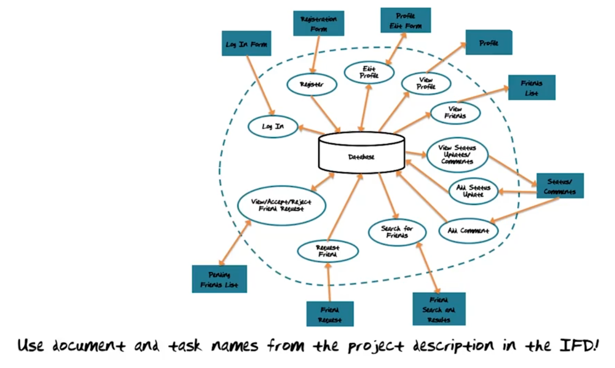
Example from Lectures

Slide 7
Tasks
Log in
View Statistics (main menu)
View reports
View Holidays
Edit Holidays
View audit log

Slide 8
Documents
Input | Output
Log in Form Edit holidays | View holidays View reports View audit log Main Menu

Slide 9
Main Menu
Log in Form
View Holidays
View Statistics
Log in
View Holidays
Database
View audit log
Edit Holidays
View Audit Log
View Reports
View Holidays
View Reports

Slide 10
Data Type and Formatting
Value | Type | Format
Store Number | integer
Store Phone number | string or integer | 10 digit phone number, (_ _ _)-_ _ _-_ _ _ _
Store district | String
District number | integer
Store City | String
State | String | 2 letter abbreviation, ex. TX
Product PID | (probably integer)
Product name | string
Manufacturer name | string
Product category | string
Retail price | Float | 2 decimal places
Discount date |  | mm-dd-yyyy
Discount price | Float | 2 decimal places
Holiday name | String
Holiday date |  | mm-dd-yyyy
Sold date |  | mm-dd-yyyy
Sold Quantity | Integer

Slide 11
Data Type and Formatting Cont.
Value | Type | Format
All users
Employee ID | Integer or String | 7 digits (may have leading 0s) ex. 0010423
password | String | Last 4 ssn + ”-” + Last name
name | string | 25 char. max
Assigned district | List | Multi value - list of district numbers
audit log
Time stamp | Date time | mm-dd-yyyy hh:mm:ss

Slide 12
Contraints

